Slide 1
MAR 530: Ecosystem Based Fisheries Management
Lecture 9
Ecological Risk Assessment for EBFM
www.mycourses.umassd.edu
3 April 2015

Slide 2
Last Time…
Aggregate models
Ecosystem models
Pros and Cons of using ecosystem models

Slide 3
Today’s Outline
Integrated Ecosystem Assessments
Ecological Risk Assessment for IEAs
Discussion on:
Fletcher 2005
Smith et al. 2007
Levin et al. 2009
Hobday et al. 2011

Slide 4
One Main Theme Throughout Course
CONFRONTING TRADEOFFS

Slide 5
Simplified Schedule
Week | Theme | Topic
1/30 | Context | Introduction, What is EBFM?
2/6 |  | Challenges facing fisheries, what can EBFM offer?
2/13 |  | Guest lecture: case studies of EBFM
2/20 |  | Types of advice, decision theories, goal-setting
2/27 | Operational | Bycatch, habitat, and spatial management
3/6 |  | Ecosystem indicators
3/13 |  | Extended single-species and multispecies models
3/20 |  | SPRING BREAK
3/27 |  | Aggregate and system models
4/3 |  | Ecological risk assessment
4/10 | Institutional | Societal and economic considerations
4/17 |  | Governance and management institutions
4/24 | Holistic | Evaluating tradeoffs
5/1 |  | Moving towards ecosystem based management
5/8 |  | Final exam: Project Presentations

Slide 6

Integrated Ecosystem Assessments (IEAs)
What is an IEA?
‘a synthesis and integration of information on relevant physical, chemical, ecological, and human processes in relation to specified management objectives’
(Levin et al., 2008, 2009)
A framework for the process of doing Ecosystem Based Management
e.g. http://www.noaa.gov/iea/

Slide 7
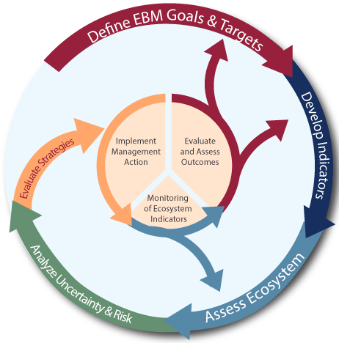
NOAA Fisheries IEA program

Slide 8

Risk

Slide 9
Risk
Risk is the probability of something bad happening.
Economic terms, risk is defined as the expected loss from some event.
Implies two components:
Likelihood an event will occur
Magnitude of effect if it occurs

Slide 10
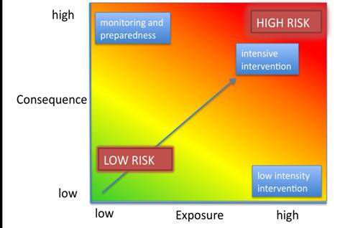
Risk: Exposure and Consequence
www.naturalcapitalproject.org/

Slide 11

Risk assessment in fisheries
“…the formulation of advice for fisheries managers in a way that conveys the possible consequences of uncertainty. This advice is in the form of an evaluation of the expected effects of alternative management options, rather than recommendations.”
“Much fisheries risk management is informal, i.e., nonquantitative, undocumented, and loosely linked (if at all) with a risk assessment.”
(Francis & Shotton 1997)

Slide 12
Risk analysis in fisheries
The term risk analysis has been used frequently.
In a single-species context, this often involves quantitative modeling to derive expected probabilities for events, sometimes given management actions.
Population Viability Analysis (PVA) is an example of single-species risk analysis

Slide 13
Population Viability Analysis
Formal mathematical method for extinction risk assessment for individual species.
Uses species characteristics and environmental variability to forecast population health and extinction risk.
Links planning, research, data collection, assessment of vulnerability, and ranking of management options.
Often numerical methods are used to derive probability distributions for the time to extinction.
e.g. Dennis et al. (1991)
Figures from A.Punt

Slide 14
Ecological Risk Assessment for EBFM
What is an ecological risk assessment (ERA)?
Why might we do an ERA?
When might we do an ERA?
Can ERAs help us in an EBFM (or EBM) context?

Slide 15
Ecological Risk Assessment
There is no single ecological risk assessment.
The term refers to a class of frameworks which can address a range of fishery management goals.
Typically less quantitative methods.
Wider inclusion of factors.

Slide 16
Why might we do Ecological Risk Assessment?

Slide 17

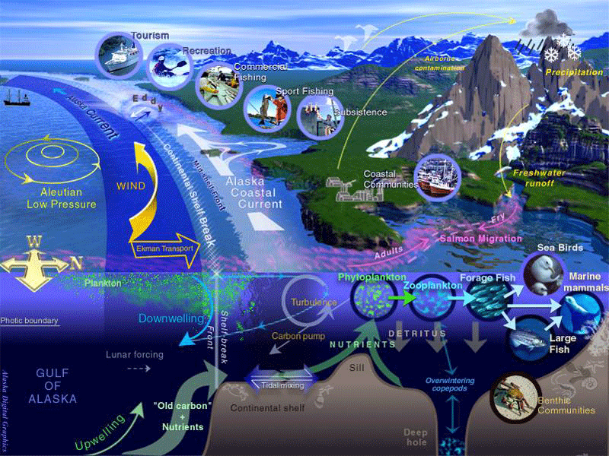
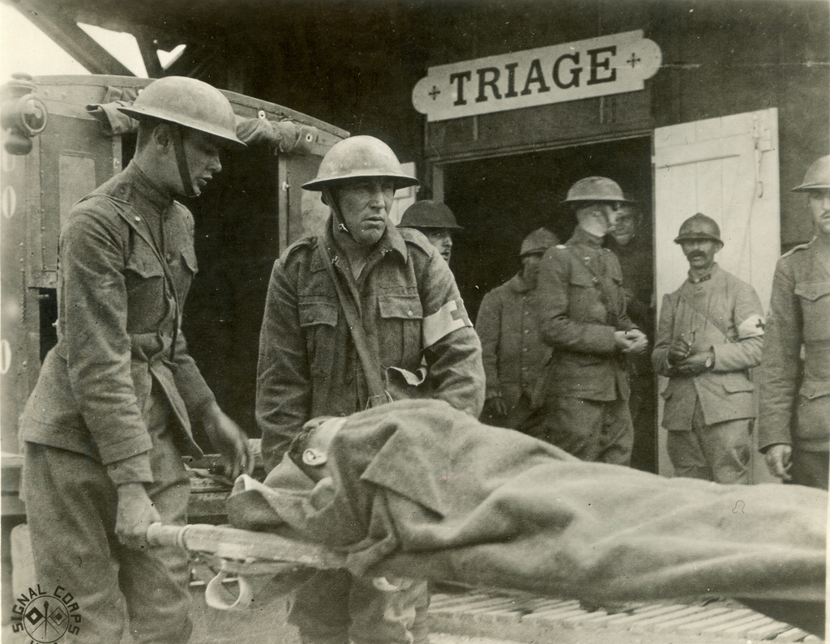
Triage
The art of figuring what is most critical to deal with, in order of priority…

Slide 18
Possible categories of ecosystem triage
Geography of the ecosystem
Key epecies
Abiotic factors
Species interactions
Aggregate properties
System level properties
Fisheries context

Slide 19
When might we do Ecological Risk Assessment?
Dealing with limited information
Might be available, but categorical or qualitative
Insufficient data to apply modeling approaches from last few weeks
Data-poor: the information is not available
Data-rich: Information not available for some key factors in an ecosystem.
Resource-limited: ERAs can be a method of identifying how to allocate / prioritize these.

Slide 20
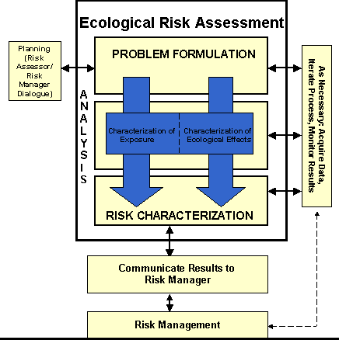
Ecological Risk Assessment procedure: EPA

Slide 21
Risk Assessment
Identify attributes of ecosystem deemed worth evaluating
Identify features of those attributes that indicate response to potential perturbation
Identify factors that can perturb the ecosystem attributes of interest
Rank or Weight or Assign Probability to the risk of attributes responding to perturbing factors.
Can also evaluate risk for range of harvest strategies

Slide 22
Benefits of ERA for EBFM
Handle a wide range of factors
Framework for prioritizing action/assessment/resources.
Outputs are often intuitive and informative to managers.
Worth considering as one approach towards implementing EBFM.

Slide 23





Risk assessment methods are becoming more prevalent in the literature, particularly gray literature.

Slide 24
Some Risk assessment frameworks
Ecological Risk Assessment for the effects of fishing (ERAEF, Hobday et al.)
Tiered approach
Prioritize resources for varying levels of management
Modified to UK, USA (data-poor stocks)
Ecological Risk Assessment Framework (ERAF)
Canada North Coast
Multiple anthropogenic stressors
Productivity-Susceptibility Analysis
Cumulative Impacts, California Current IEA
Comprehensive Assessment of Risk to Ecosystems (CARE)
Data poor fisheries and developing countries
Risk-based framework (RBF), Marine Stewardship Council
Used to evaluate when other data are missing
Fish stock climate vulnerability assessment (NOAA)
Rapid assessment of vulnerability to climate change
Climate & ocean conditions, species distribution, and life history

Slide 25
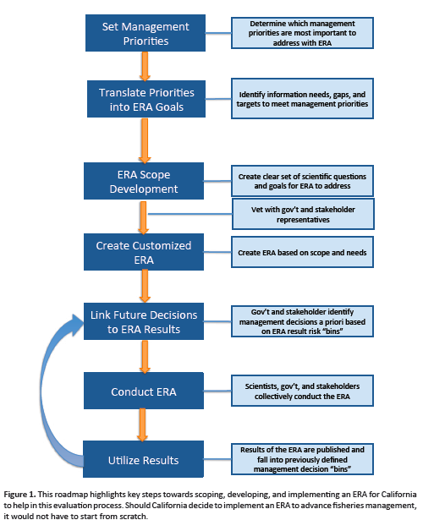

Slide 26
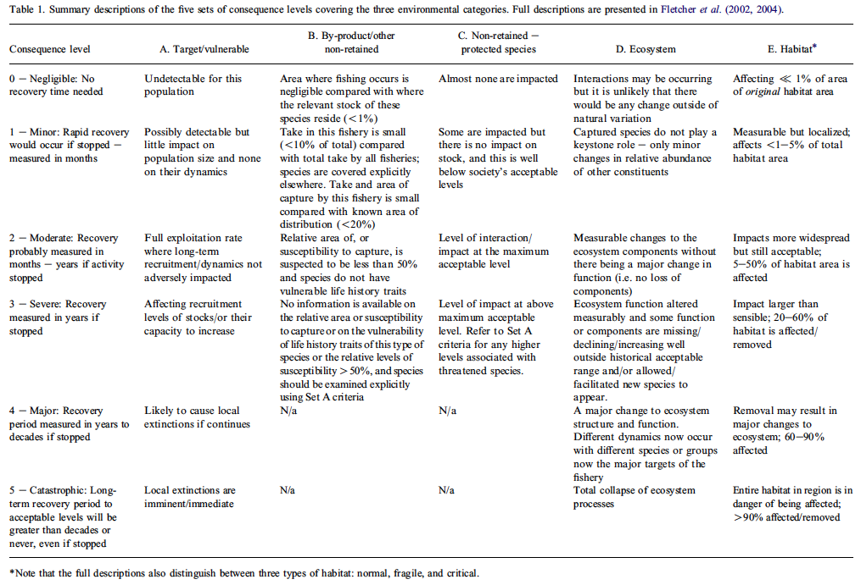
Categorical ranking – Fletcher (2005)

Slide 27
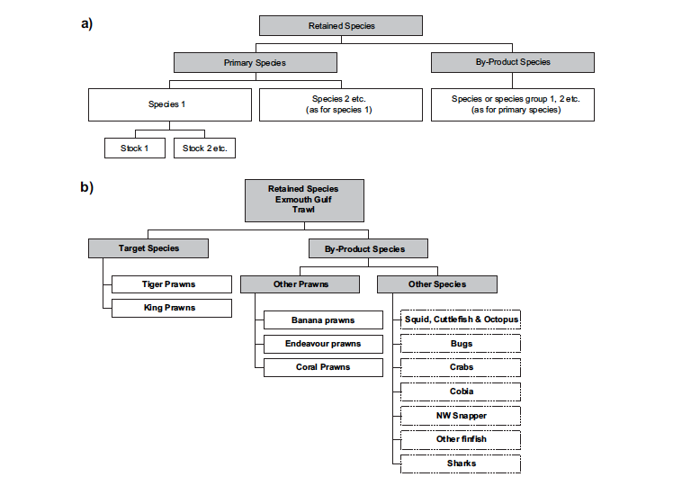
Decision tree approach (Fletcher 2005)

Slide 28
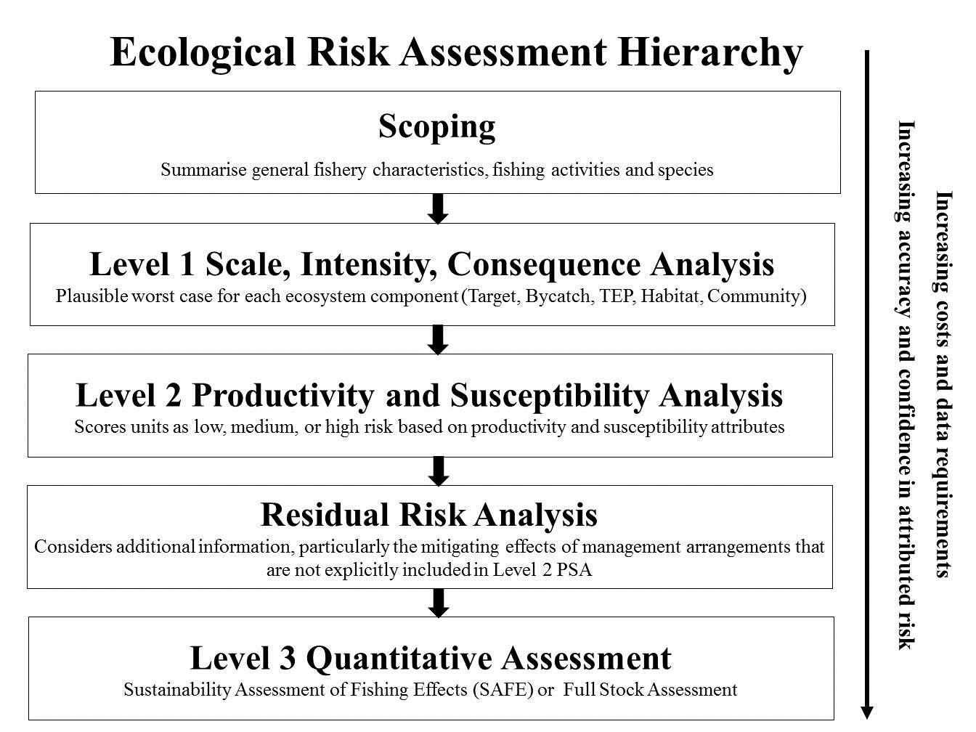

Slide 29
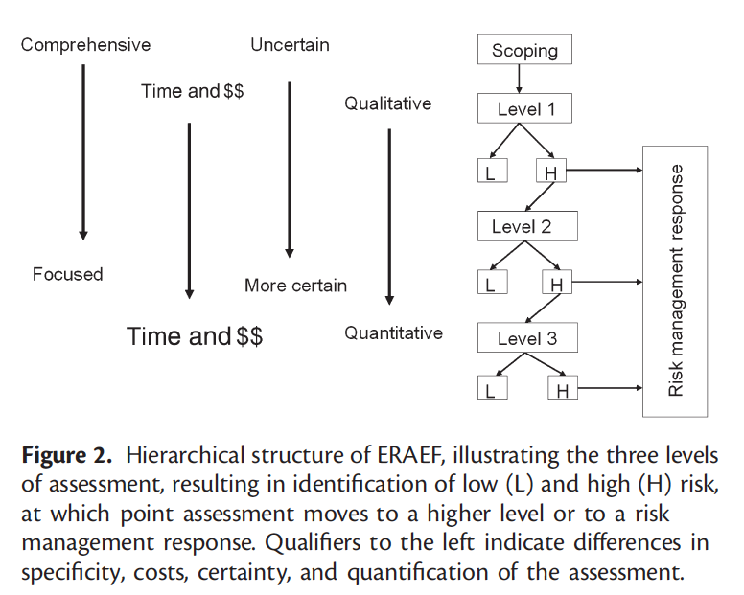
ERAEF (Australia) – Tiered Approach
Smith et al. 2007

Slide 30
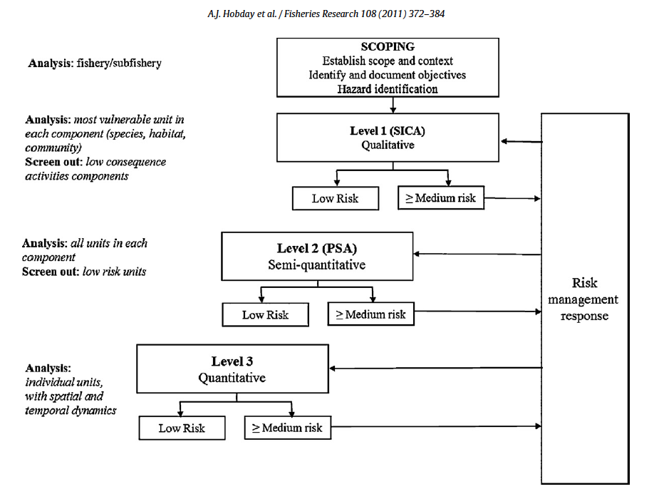
ERAEF (Australia) – Tiered Approach

Slide 31
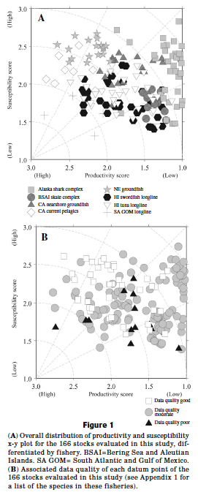
Productivity-Susceptibility Analysis
Semi-quantitative.
Rapid tool, uses:
life history characteristics (productivity)
level of susceptibility to fishery
Multiple attributes for each axis
Additional scoring associated with data quality.
Determines relative inherent vulnerability.
Stobutzki et al. (2001)
Patrick et al. (2010)

Slide 32
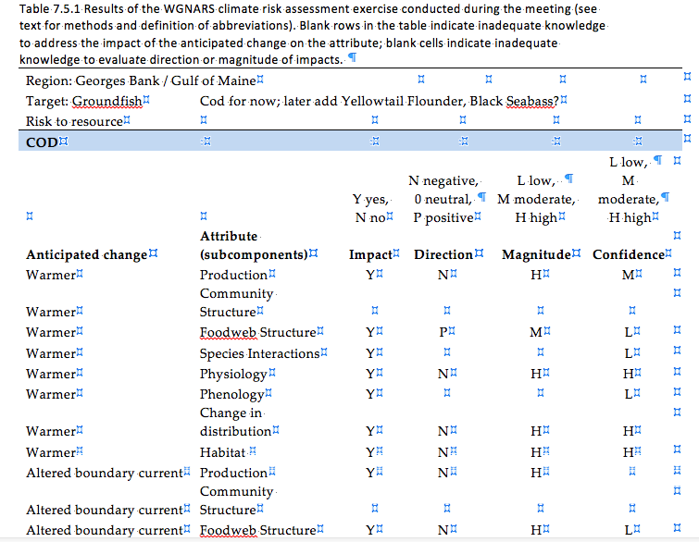
Northeast US example, climate risk to cod

Slide 33
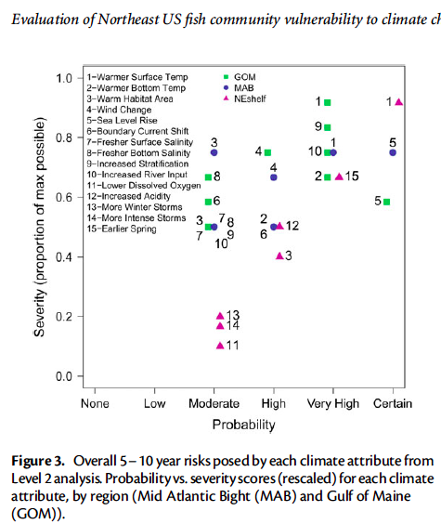
Evaluation of Northeast US fish community vulnerability to climate change (Gaichas, Link & Hare 2014)

Slide 34
Challenges for qualitative ERAs
Often rely on:
Expert judgement
Integration of scientific and other knowledge
Are the right people in the room?
How to combine information from different knowledge bases?
Formal methods for expert elicitation and weight of evidence approaches can help.

Slide 35
Risk assessment approaches….
Must include Planning and Scoping
Allow for inclusion of wide range of information.
Are applicable for both data-poor and data-rich situations
Flexible, have the ability to compare across stocks, taxonomic groups, regions, gears, fisheries, and ecosystems.
Methods are variable, and range in complexity, but usually output probable risk to ecosystem component relative to perturbation or management strategy

Slide 36
Key takeaways
IEAs are a process within which the adaptive management cycle can be applied to ecosystem based management.
Scale of IEAs is EBM not EBFM
Risk assessment provides framework for doing ecosystem fisheries triage.
Identify tradeoffs and important factors holisticially.
Can be qualitative and semi-quantitative.
Rapid approach for prioritizing and identifying next steps

Slide 37
What do we need?
“autopsies” of what worked/didn’t work with respect to the range of risk assessment approaches.
(how do we evaluate these?)
Development of ‘Best Practices for ERA’
Comparison among risk assessment approaches
Uptake of risk assessment as part of the management framework and process.

Slide 38
Doing EBFM
Questions?

Slide 39
What’s Next?
Socio-economic factors for EBFM
Discussion on:
Yaffee 1996
Endter-Wada et al. 1998
Browman & Stergiou 2005
Fulton et al. 2011

